Slide 1
Does Smartphone Usage Affect the Amount of Sleep an Individual Obtains?
Irene Rong, Ariel Friend , Giovanni Guillaume

Slide 2
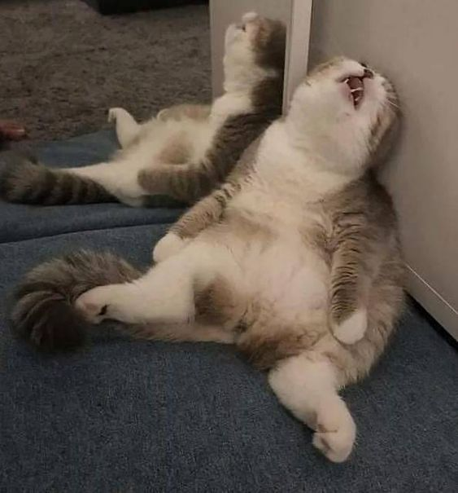
Why sleep?
Sleep deprivation is very common for college students and results in negative effects on the body, such as
memory loss → low GPAs
Trouble with thinking and concentration
High blood pressure
Notes:
Sleep plays an important role in maintaining physical mental and emotional health
Mixed factorial design

Slide 3
Introduction

Slide 4
Objective
This experiment examined the relationship between smartphone use and the amount of sleep that a college student acquires
Amount of sleep measured by a polysomnography
We hypothesized that
phone usage before bed would have an inverse correlation with the amount of sleep an individual acquires
freshmen would get significantly less sleep than seniors

Slide 5
Literature Review
Results from West’s et al. (2011) experiment presented a positive correlation between the hazardous blue lights displayed from smartphones and increased melatonin suppression
Melatonin is a hormone that helps regulate sleep and is normally excreted in response to darkness
Melatonin suppression may lead to sleep deprivation

Slide 6
Literature Review (cont.)
Research conducted by S. Kim, M. Kim, Park, J. Kim, and Choi (2018)
Indicated that individuals who utilize devices for internet use tend to acquire sleep loss more commonly than those who don’t
According to Khullar (2012),
Sleep is defined as the result of a continuous sleep and wake cycle, or circadian rhythms
Circadian rhythms
Work by either suppressing or synthesizing melatonin…
… which signals the body to either sleep or wake up

Slide 7
Literature Review (cont.)
In a recent study by W. Chen and J. Chen (2019), the importance of sleep is emphasized.
The recommended amount of sleep for adolescents are between 7.5 to 8.5 hours a day
The average amount of sleep many obtain is approximately two or more hours less than the recommended time.

Slide 8
Method

Slide 9
Participants
Demographics
24 Males 26 Females
Mean age 20.74 SD1.89
56% white
20% Black
16% Asian
6% American Indian
2% Pacific Islander
Recruitment method: Flyers
50 Healthy Individuals
18 - 24 Years of Age
Freshmen and Senior Students
Compensation: Gift Card to Insomnia Cookies
Notes:
Once again this experiment aims to look at the effects smartphone usage before bed has on students specifically first and last year undergraduate students in the University at Buffalo
Students chosen for this experiment were those who responded to an advertisement posted around the University
Each participant was required to fill out a physical to ensure they had no medical history that would influence the data. Participants with health issues such as depression, narcolepsy, or insomnia were excluded from the experiment.

Slide 10
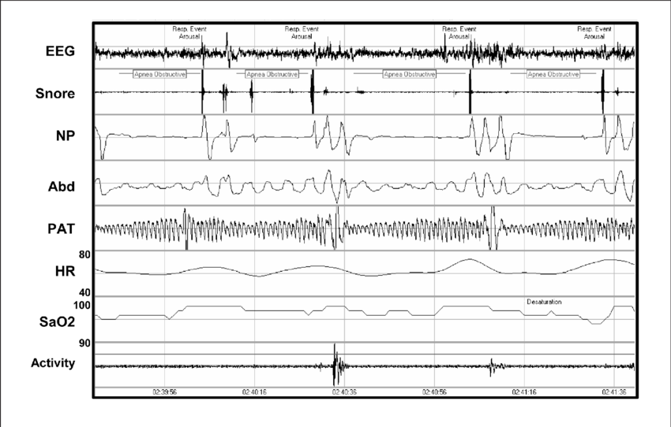
Experimental Method
6 Night Laboratory Study
On site laboratory assistants
Shuttle bus service
50 Smartphones: Iphone 5
Each room will be equipped with
Thermostat: 60-67° F
White walls
A Twin XL bed
2 Pillows and a blanket
A Nightgown
A Polysomnography machine
A Security Camera
Notes:
This experiment lasted for 6 nights and was held at the Buffalo Niagara Sleep Medical Center
Each night of the experiment between 7pm and 8pm shuttle bus services were made available to pick up participants and bring them to the lab. This service was offered again between 8am and 9am to take participants back home. It would not be ethical to have students miss classes and assignments on account of our experiment

Slide 11
Experimental Method
Participants...
Arrived -
8:15 pm
Completed check ins - 8:35 pm
Completed video demo - 8:40 pm
Mixed Factorial Design
No smartphone Condition
Smartphone Condition
Same participants
All participants must be in their assigned rooms by 9:30 pm
Assistants…
Completed walk through -
9: 45 pm
Turned off lights -
10:30 pm

Slide 12
Nights 1 - 3: No Phone Condition
Between 9:30 pm and 10:30 pm, participants would wait for their walk through to be completed and get ready for bed
25 rooms randomly assigned to freshmans
25 rooms randomly assigned to seniors
Notes:
In the first trial nights 1-3 participants will not be able to use their phone

Slide 13
Nights 4 - 6: Phone Condition
Between 9:30 pm and 10:30 pm, participants were required to use the smartphone provided for a duration of 30 minutes
Time will be measured using built in application
Same Participants
25 rooms randomly assigned to freshmen
25 rooms randomly assigned to seniors
Notes:
Researchers did not restrict participants from specific applications however they were not allowed to make personal phone calls
After the 30 minute mark, participants smartphones automatically powered off giving ensuring each individual experienced the same amount of time with the blue light.

Slide 14
Results

Slide 15
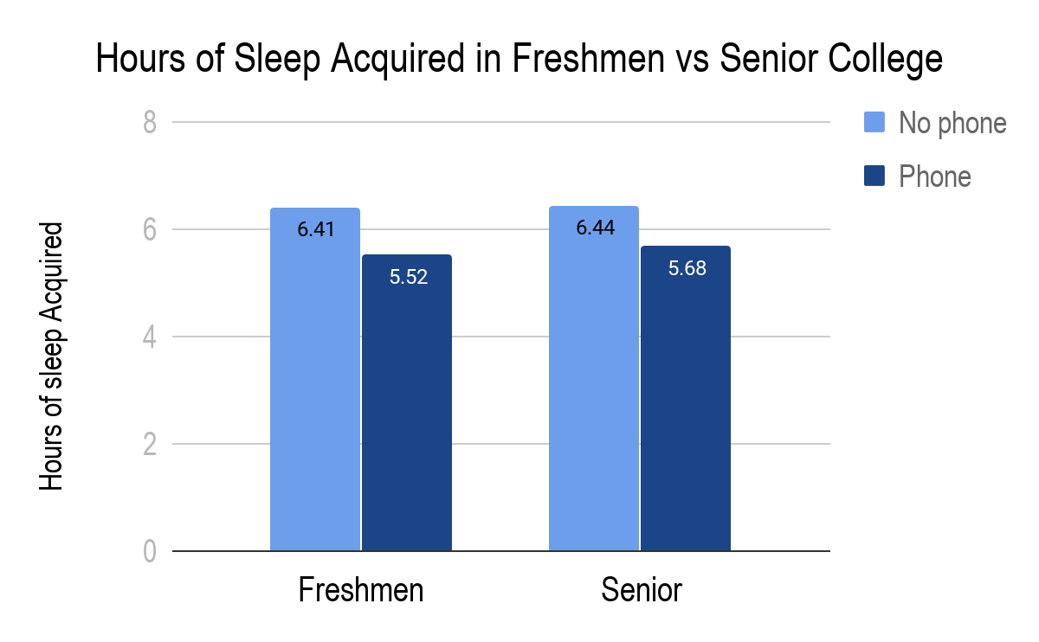
Results
Freshmen with no phone:
M = 6.41, SD = 1.46
Freshmen with phone:
M = 5.52, SD = 1.18
Senior with no phone:
M = 6.44, SD = 1.47
Senior with phone:
M = 5.68, SD = 1.47

Slide 16
Results
Significant difference:
F (1,48) = 18.86, p = <.001
No significant difference:
F(1,48) = .119, p = .731

Slide 17
Discussion

Slide 18
Discussion
First hypothesis was accepted:
No phone condition obtained more sleep than phone condition
Second hypothesis was rejected
There were no differences between the amount of sleep an individual obtained and what year the student was in for college.

Slide 19
Limitations
Did not have participants in the lab setting for the full 6 days.
Having a designated sleep time.
Did not account for wavelength of devices.
Notes:
Individual differences
Personal eating habits are not known
Do not know what they do in the time that they are away from the lab. Ex = nap, working out.

Slide 20
Future Research
Blue Light vs Red Light vs No Light
Different intensity of blue light emitted
Notes:
Transition between seniors in high school and freshman in college and the sleep they get between phone and no phone conditions.

Slide 21
Take home message
Reduce your phone usage before bedtime
Notes:
Since college students are already utilizing electronic devices more often, try to reduce your phone usage before bedtime to acquire more sleep at night. Instead, try to have school work done a few hours before bed. We hope that this study provides a baseline to understanding how blue light affects sleep.

Slide 22
References
Chen, W.-L., & Chen, J.-H. (2019). Consequences of inadequate sleep during the college years: Sleep deprivation, grade point average,
and college graduation. Preventive Medicine, 124, 23–28.
Kim, S.Y., Kim, M.-S., Park B., Kim, J.H., & Choi, H. G. (2018). Lack of sleep is associated with internet use for leisure. Plos One,
12, 1-12.
Khullar, A. (2012). The role of melatonin in the circadian rhythm sleep-wake cycle: A review of endogenous and exogenous melatonin.
Psychiatric Times, 26–32.
West, K. E., Jablonski, M. R., Warfield, B., Cecil, K. S., James, M., Ayers, M. A., … Brainard, G. C. (2011). Blue light from
light-emitting diodes elicits a dose-dependent suppression of melatonin in humans. Journal of Applied Physiology, 110,
619–626.

